Slide 1

PARKSCAPE
SAFETY FIRST!
www.parkscape.org.za

Slide 2
What is Parkscape?
Association of concerned community members seeking to create SAFETY – from crime and fire – in the transition zones of Table Mountain National Park.
Starting with Lower Tokai as a potential model.

Slide 3
Why Parkscape?
Increasing incidents of crime in TMNP particularly near urban edge.
Number and intensity of wild fires affecting urban edge are increasing.

Slide 4
The history:
1994 Investigation into the use of land to be donated to conservation in the Cape Peninsula resulted in a report advising that:
  lower slopes of the mountain (below the contour path) remain as is,
  plantations retained,
  public have FREE access to recreational activities.

Slide 5
1996 A second report advised that the public’s interest in what is now known as the Table Mountain National Park:
    be protected,
    no one group’s interest dominates,
    use of the area for recreational purposes be recognised.
    any managing Authority of the Park to act:
      as a custodian serving the public’s interest
      do so maintaining transparency, adaptability and principles of participation.

Slide 6
1998 Land handed over to National Parks Board (SANParks) for management.
2001 Minister of Water Affairs & Forestry decides to exit forestry in the Western Cape.
2004 Cape Floral Region Protected Areas declared a World Heritage site.
2005 MTO Forestry starts negotiating with government to reverse the forest exit strategy. (In 2008 - partial reversal is granted, but does not include Tokai or Cecilia – or the Boland.)

Slide 7
2006 SANParks produce a Draft Management Framework, and the original Parkscape is formed.
2007 Parkscape dissects the Draft Management Plan; provides comprehensive report to City – and one of the outcomes is…

Slide 8
Tokai Cecilia Management Framework
2005 - 2025
SANParks adopted a 20 year vision, presenting an “image of the future”.
Plan refined into broad diversity, heritage, eco-tourism & recreational objectives.
Innovative compromise resulted in certain designated “transition areas” in Tokai & Cecilia:
  to be replanted with non-invasive exotic shade trees along the periphery and consolidation of existing planted areas.

Slide 9
The Framework’s vision statement:
‘To manage Tokai and Cecilia into the future in terms of legal requirements, applicable policies and the lease agreement and to accommodate the conservation of biodiversity and heritage, development of eco-tourism opportunities and recreational activities so as to fully integrate the area into the Park.’

Slide 10
And about the recreational aspect…?
The objectives stated are:
To continue to provide opportunities for existing recreational activities in a growing city and to relieve pressure on high priority conservation areas;
To provide shaded areas for recreational purposes without compromising the biodiversity objectives.

Slide 11
So about these “Transition Areas”
‘The concept provides for certain designated “transition areas” to be replanted with non-invasive exotic trees in limited areas along the periphery and to consolidate existing planted areas.
This is a long term conservation strategy which accommodates both shaded recreational needs and heritage concerns for maintaining planted landscapes along the Urban Edge, whilst not undermining the core biodiversity objective or the rehabilitation potential of these designated “transition areas”.’

Slide 12
How will the “transition areas” work?
In the identified “transition areas”, pine harvesting will be followed by an initial controlled burn.
Then there’ll be an 8 year period of fynbos growth for seed to be dispersed into the soil.
Thereafter appropriate pine trees can be re-planted to provide shaded recreation areas and for urban interface landscape purposes.
After about 20 years these pines are again harvested for fynbos to return to the area, the seed having already been set in the soil.

Slide 13
HOW IT SHOULD LOOK…

Slide 14
Looks great, so what’s the problem?
Due to 2015 fires, uneconomical for MTO to remain.
MTO will be felling and leaving – as per the terms of their lease with SANParks.
They have agreed to be out by 2018 – 7 years ahead of original schedule.
Felling will take place any time between now and end 2017.
We do not have a date.
The Management Framework does not accommodate this early exit.
No new planting has begun.

Slide 15
We asked SANParks…
What are the plans for Lower Tokai?
Requests for revised plans for the area have been ignored.

Slide 16
And we asked…
What is SANParks going to do about safety?
A request to discuss safety was advised to be premature…

Slide 17
We asked to engage …
And received no response
We even asked to engage via Twitter - we were “blocked”.

Slide 18
What does all this tell us?
The founding nature of the Park – one focused on the public’s interest - has been lost.
The Park’s primary objective is not people but biodiversity and revenue.

Slide 19
Some key concerns
TMNP is an urban park requiring a very different and people inclusive strategy.
Across the Park there are issues regarding management – i.e. safety, access, fees, fires, failure to engage with the public and a lack of transparency.
In Lower Tokai the tragic murder of Franziska Blöchliger has made it apparent how much of a risk the dense fynbos poses – particularly on the urban edge.

Slide 20
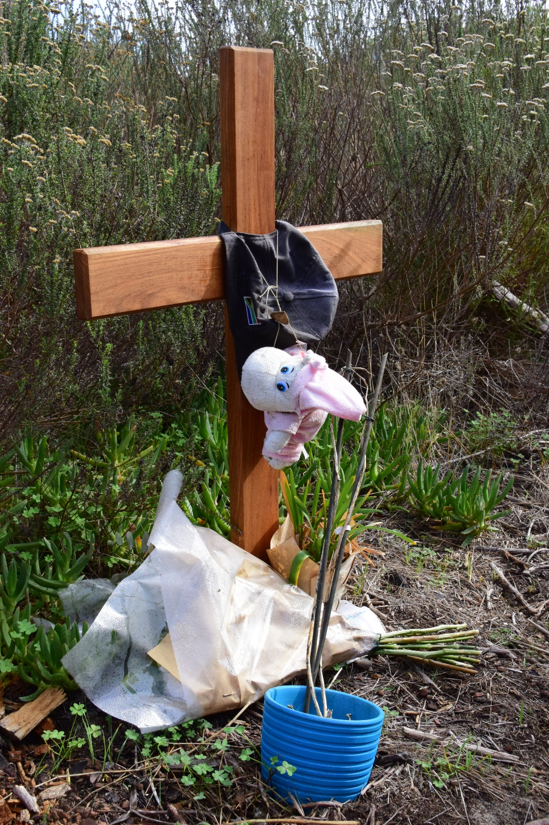
LET US NEVER FORGET
Notes:
20

Slide 21
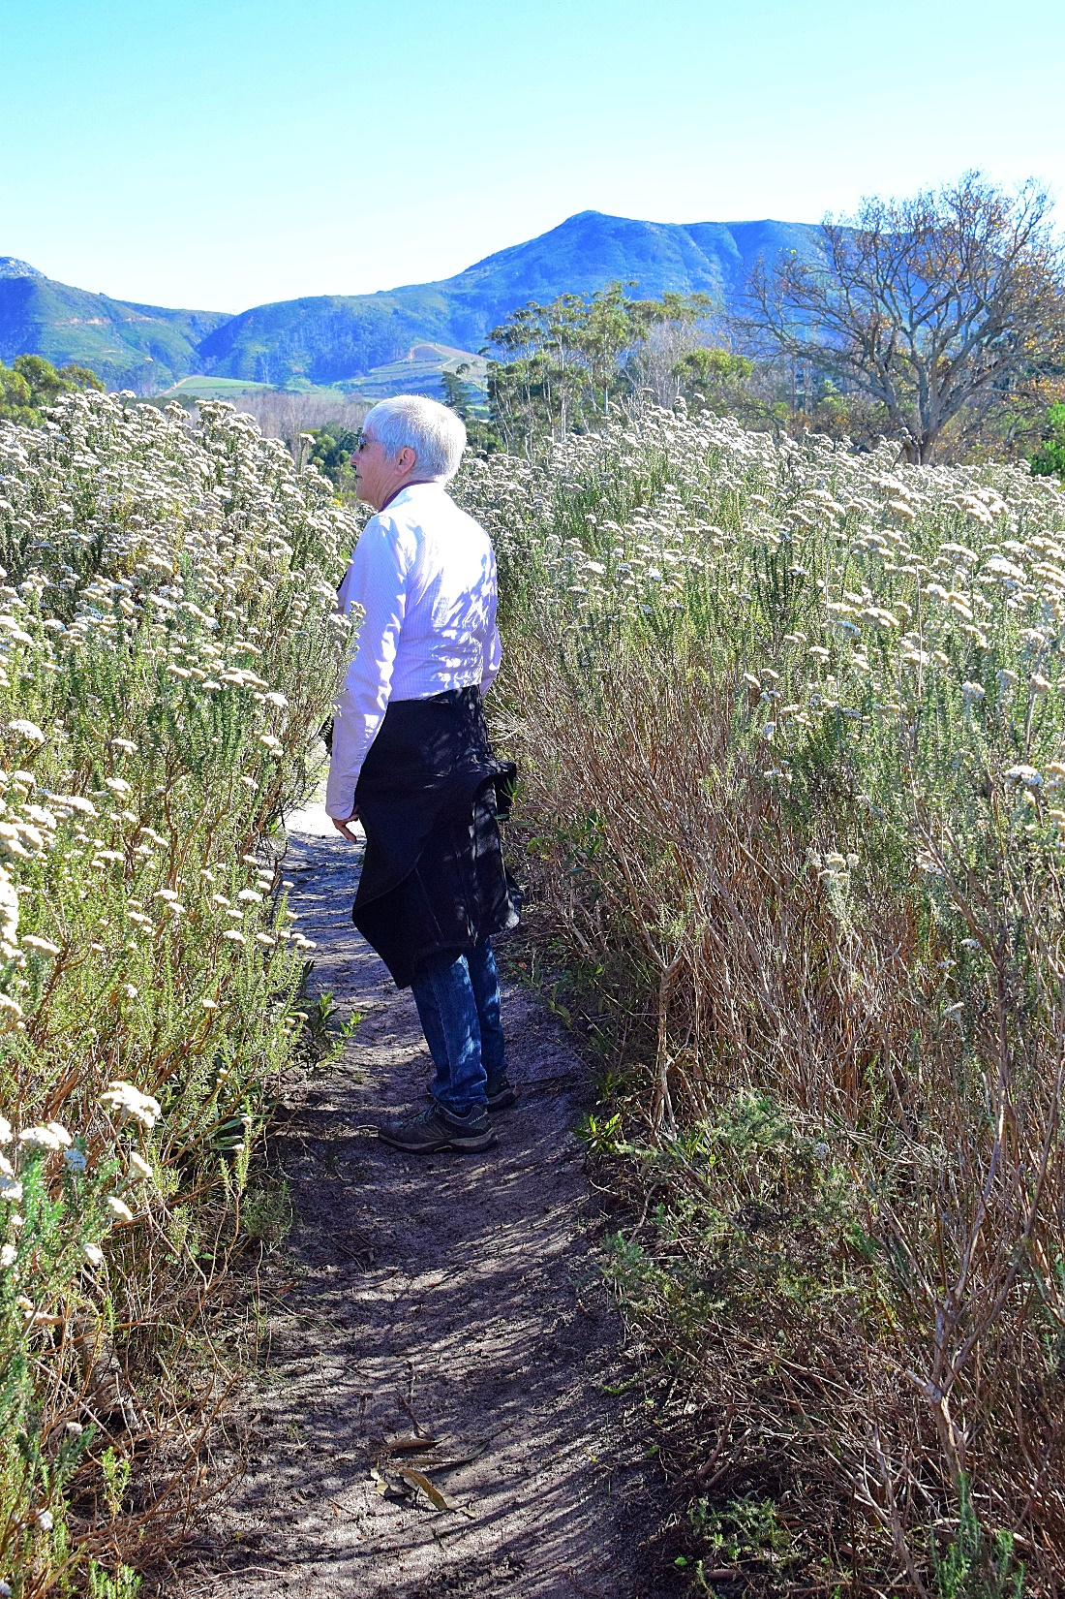
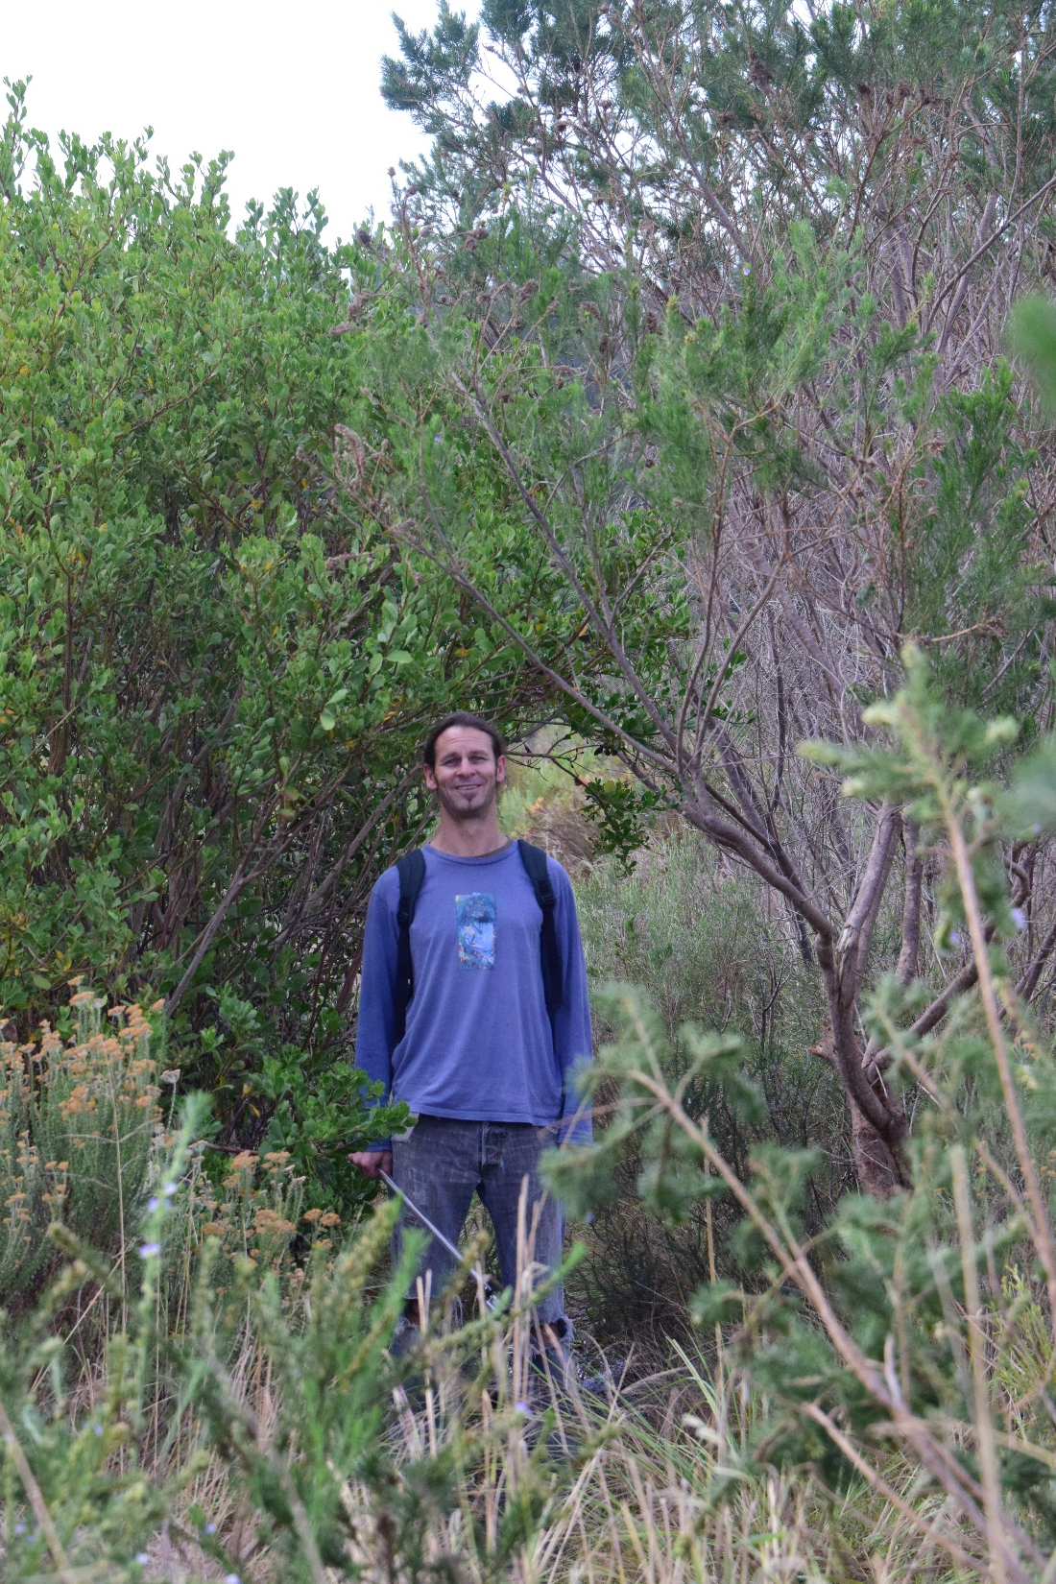
HERE’S WHERE THE PROBLEM LIES

Slide 22
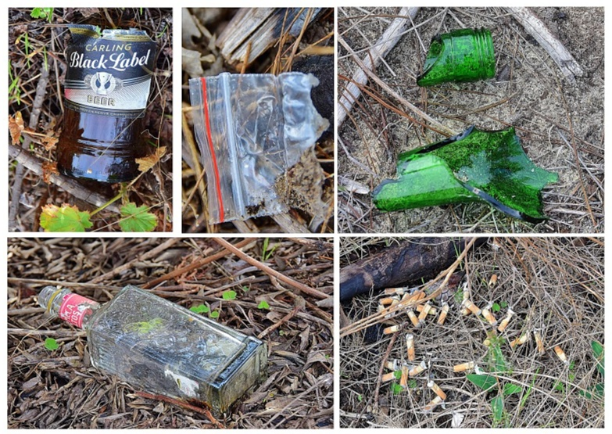
And this is some of what we found in the fynbos…

Slide 23
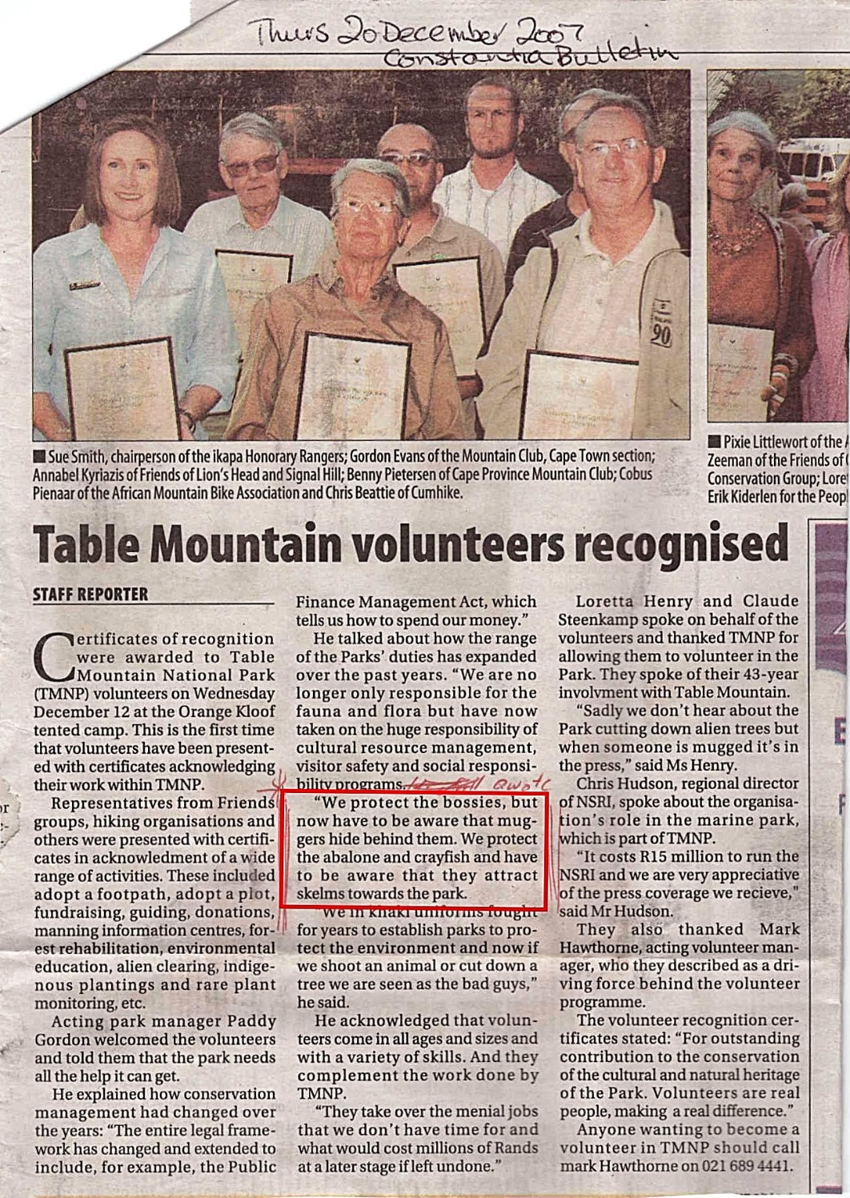
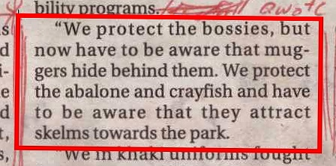
THE IRONY:
“We protect the bossies, but now have to be aware that muggers hide behind them.”

Slide 24
Lower Tokai concerns
Risk re: crime and fire on urban edge.
Lack of visible security/patrolling.
Increasingly dense and head-height (and higher) fynbos.
Loss of safety, currently provided by visibility through tall-stemmed trees.
AND
Apparent deviation from toughly negotiated Tokai Cecilia Management Framework.

Slide 25
Do we know what will happen?
Lower Tokai plantation will be felled any time between now and next year.
Premature felling of the pines means the nature of “transition areas” as outlined in the Framework may be lost.
Entire area may be given over to further fynbos in the interests of conservation.
Aesthetic of Tokai may change forever.

Slide 26
Most critically…
The risk of crime and fire will be brought right to the urban edge.

Slide 27
The realities are…
SANParks cannot simply override the Tokai Cecilia Management Framework.
Our National Constitution states that everyone has the right to an environment that is not harmful to their health or well-being.
There has to be consultation with the surrounding community…

Slide 28
And there has to be…
…a formal public participation process before there can be a deviation or review of the existing Management Framework.

Slide 29
What you can do…
Write
  to your local councillor
  to Alderman Purchase
  FelicityAnne.Purchase@capetown.gov.za
  to the press
Join our mailing list via our website
www.parkscape.org.za
LIKE our Facebook page - facebook.com/parkscapesa
Follow us on Twitter. @parkscapesa

